Slide 1

Data Analytics Project
Shweta Arande
Net id: mq3395

Slide 2
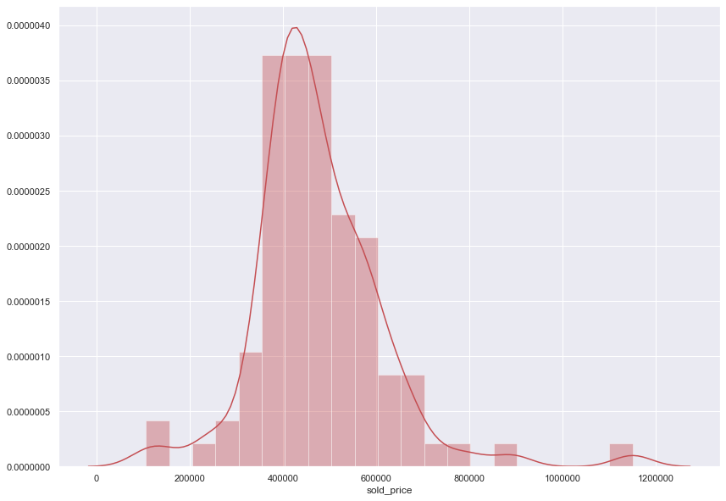
Question-1 Regression Analysis to predict house values/prices in Solano County
Input features(Independent variables)
No. of Beds Baths
Walkable Score’
Transit score
Bikeable score
Number of schools
Dependent Variables
Price
Train-Test Split
Total Data points= 194
Train data points=155 (80%)
Test data points=39 (20%)

Slide 3
Comparision between actual and predicted values
 | Actual | Predicted
0 | 510000.0 | 481590.24
1 | 430000.0 | 484922.84
2 | 360400.0 | 398563.02
3 | 495000.0 | 444919.39
4 | 572625.0 | 586196.22
5 | 390000.0 | 367093.95
6 | 580000.0 | 684130.92
7 | 460000.0 | 515396.97
8 | 395000.0 | 361274.70
9 | 490000.0 | 514437.16

Slide 4
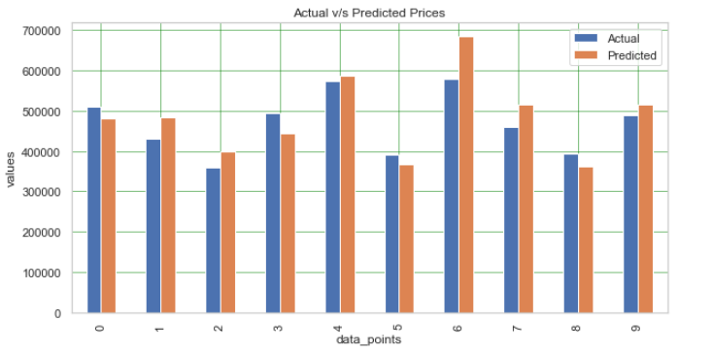
Graphical representation of actual v/s predicted prices

Slide 5
Error Rate
Mean Absolute Error: 5.3%
Mean Squared Error: 6.0%
Root Mean Squared Error:7.7%
Insights
All the error rates are less than 10% so algorithm is accurate and can make good predictions.

Slide 6
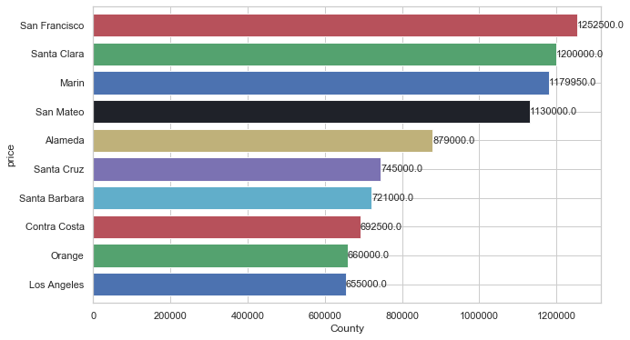
Question-2 Where are the luxury homes (Price>$2M) located for potential new buyers?
From the graph it can be seen that top 5 counties with luxury homes San Francisco, Santa Clara, Marin, San Mateo county and Alameda county.

Slide 7
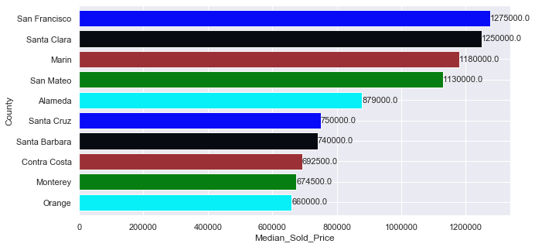
Question-3 Exploratory data analysis on house sales prices data in all counties of bay area. 1) Median house prices 2) Median dollar per square foot
1) Median house prices
Calculated median prices of all across all counties and found that San Fransisco, Santa Clara and Marin are the top three counties with highest prices.

Slide 8
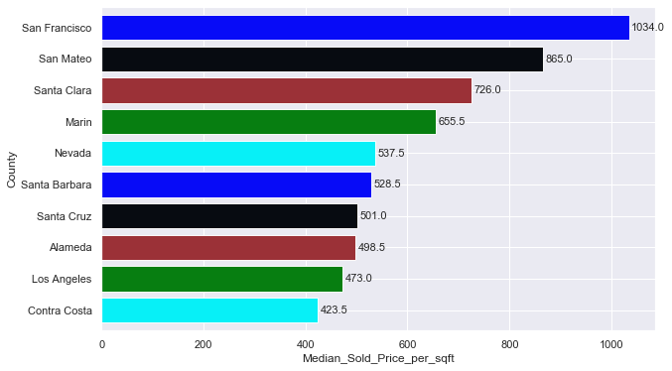
Question-3 Exploratory data analysis on house sales prices data in all counties of bay area. 1) Median house prices 2) Median dollar per square foot
2) Median house prices
Per SQUARE FOOT
Calculated median per Square Foot prices of all the counties and found that San Francisco, San Mateo and Santa Clara has the highest per square foot prices across all counties

Slide 9
Question-3 Exploratory data analysis on house sales prices data in all counties of bay area. 1) Median house prices 2) Median dollar per square foot
2) Median house prices
Per SQUARE FOOT
Calculated median per Square Foot prices of all the counties and found that San Francisco, San Mateo and Santa Clara has the highest per square foot prices across all counties

